Slide 1
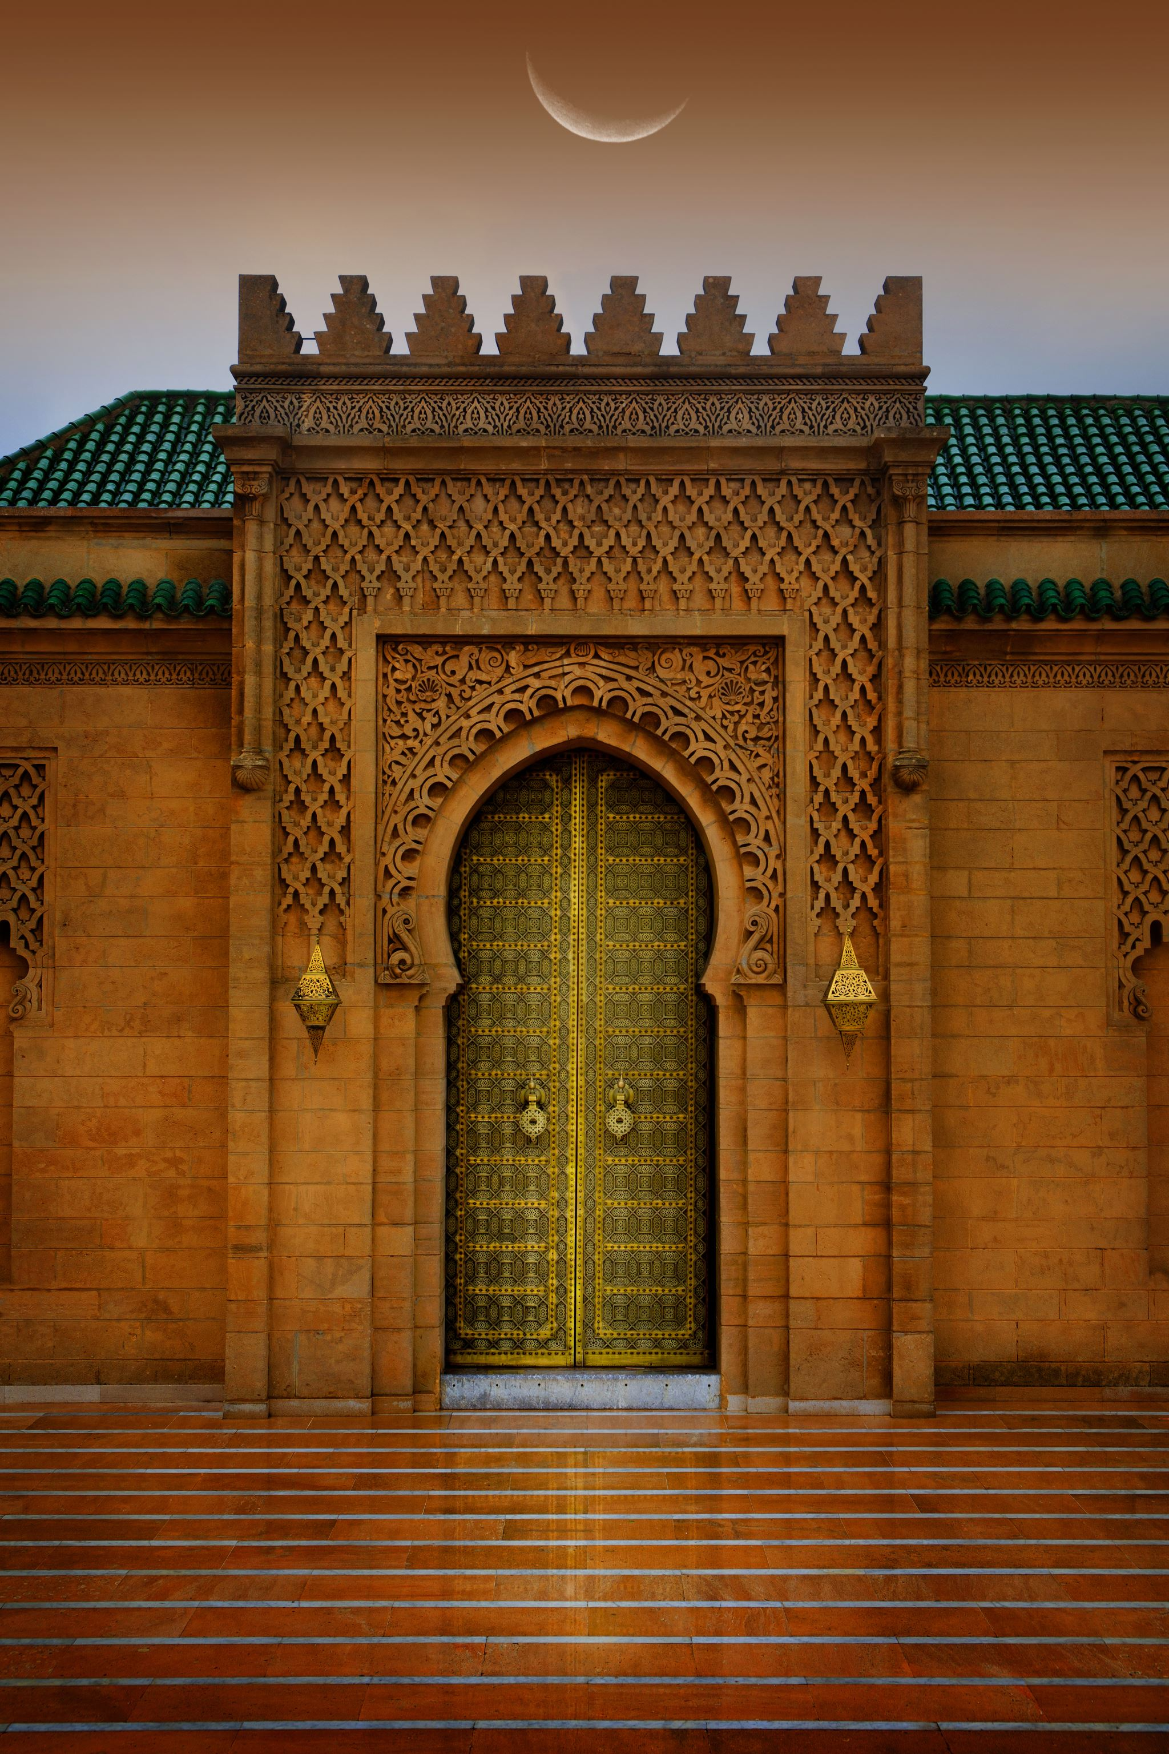
Kazakh Culture Part One
Lecture #10

Slide 2
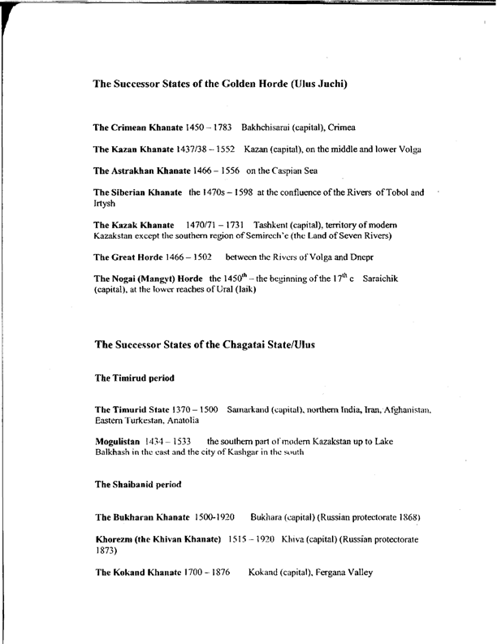
Successor States of the Golden Horde

Slide 3
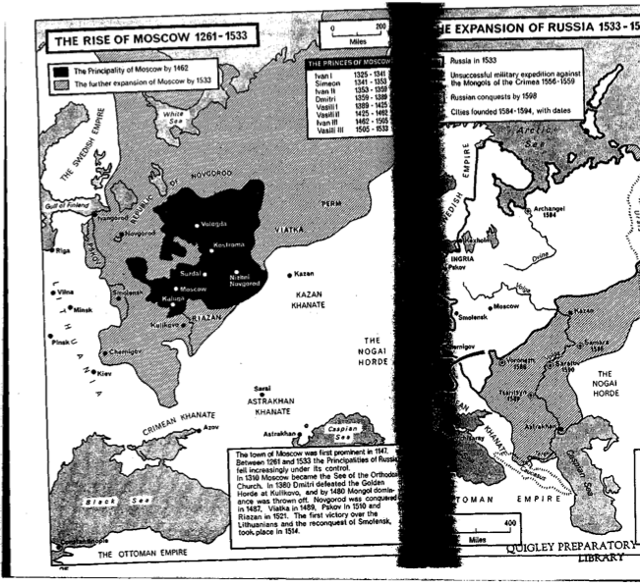
The Rise of Moscow, 1261-1533

Slide 4
Mobility
Nomad civilization has its own laws governing the organization of time and space, and nomads follow very sensitively the cycles of nature. In the words of one song, they are in continual pursuit of eternal spring. The primacy of movement serves as the basis of the nomads’ entire worldview. For them, everything that is alive is in movement, and everything that moves is alive: the sun and moon, water and wind, birds, and animals.
Migration with livestock is an unavoidable fact of survival, and during the process of natural and forced selection, sheep, goats, cattle, camels, and horses have been selected for their suitability for lengthy migrations. Indeed, the symbol of nomadism is the horse, whose praise is sung in songs, epic tales, and stories. The winged flying horse, called by various names, e.g., Tulpar, Jonon Khar, like Pegasus of the ancient Greeks, is a beloved character of legends and a source of poetic inspiration.

Slide 5
The Yurt
Nomadism would be impossible without transportable dwellings, and among Eurasian nomads, evidence of such dwellings comes from ancient times.
The yurt is the universal dwelling of nomads in central Eurasia, and represents a unique achievement of human genius. As the name of a kind of dwelling, “yurt” entered general usage from Russian. In Central Asia itself “yurt” is a polysemous word that can mean “community,” “family,” “relatives,” “people,” “land,” or “countryside.” Turkic-speaking nomads call their dwellings kiyiz üy: “felt home.”
William of Rubruck, the envoy of Louis IX of France, who traveled to Karakorum, the capital of the Mongol Empire in 1252-1254, wrote about the carts that carried felt homes of 30 feet wide and were pulled by 33 pairs of oxen.

Slide 6
For nomads, the yurt is rich in symbolism that represents both the macrocosmic and microcosmic world. Under the endless hemisphere of the sky, called Tengri, which is also the name of God among nomadic animists, the yurt duplicates this hemisphere with the round opening of the smoke hole symbolizing the sun. Set on the emerald green grass of a mountains slope, covered with white felt and richly ornamented, the yurt suggests a bird alighting on the slope to rest. At first glance quite simple, the yurt is at the heart of the traditional nomadic world view. It provides a model and symbol of humanity and the universe, and is the key to understanding nomadic civilization.

Slide 7
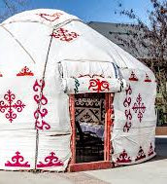
The Kazakh Yurt

Slide 8
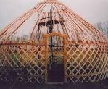
The Wooden Structure of the Kazakh Yurt
Kerege
Uyq
Shanyraq

Slide 9
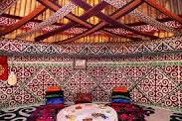
The Kazakh Yurt’s Interior

Slide 10
The Kazakh Traditional Crafts
Jewelry
Embroidery
Carpentry

Slide 11
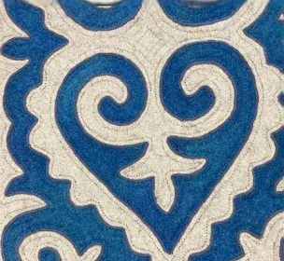
Kazakh felt carpet
Ornament
Qoshqar muiz (ram’s horns)

Slide 12


Slide 13


Slide 14


Slide 15
The Kazakh Oral Tradition
The Kazakh poetic art: proverbs, poems, eulogies,
the Kazakh traditional music: folklore
The epic and song traditions: zhyr, olen, aitys, baqsylyq, zikr
Instrumental tradition: terme, kuy,
Instruments: domra, qobyz, sybyzgy, sherter, sazgen, saz syrnai, shan qobyz

Slide 16
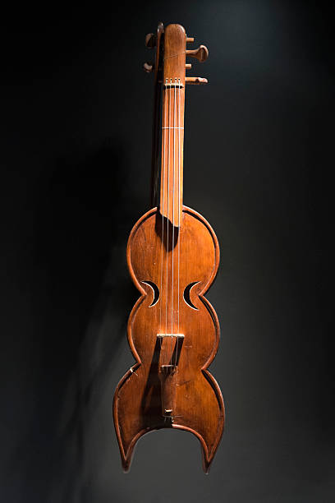
Sazgen

Slide 17
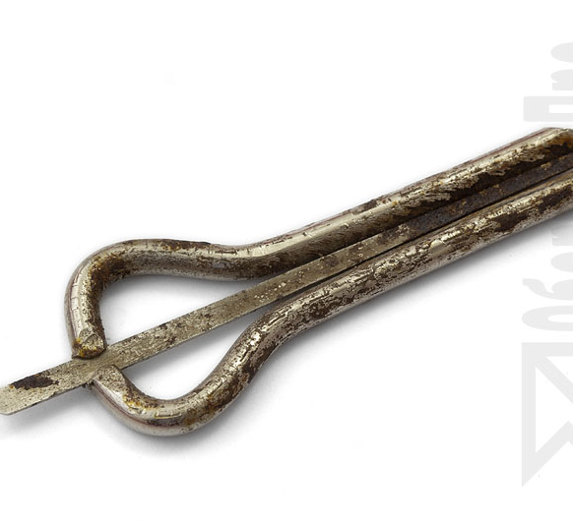
Shan qobyz

